Slide 1
LL(1) Grammars
A grammar whose parsing table has no multiply-defined entries is said to be LL(1) grammar.
one input symbol used as a look-ahead symbol do determine parser action
LL(1) left most derivation
input scanned from left to right
The parsing table of a grammar may contain more than one production rule. In this case, we say that it is not a LL(1) grammar.
Notes:
lec02-parserCFG

Slide 2
A Grammar which is not LL(1)
S → i C t S E | a FOLLOW(S) = { $,e }
E → e S | ε FOLLOW(E) = { $,e }
C → b FOLLOW(C) = { t }
FIRST(S) = {i, a}
FIRST(E) = {e, ε}
FIRST(C) = {b}
two production rules for M[E,e]
Problem ➔ ambiguity
 | a | b | e | i | t | $
S | S → a |  |  | S → iCtSE
E |  |  | E → e S E → ε |  |  | E → ε
C |  | C → b

Slide 3
A Grammar which is not LL(1) (cont.)
What do we have to do it if the resulting parsing table contains multiply defined entries?
  If we didn’t eliminate left recursion, eliminate the left recursion in the grammar.
  If the grammar is not left factored, we have to left factor the grammar.
  If its (new grammar’s) parsing table still contains multiply defined entries, that grammar is ambiguous or it is inherently not a LL(1) grammar.
A left recursive grammar cannot be a LL(1) grammar.
  A → Aα | β
    any terminal that appears in FIRST(β) also appears FIRST(Aα) because Aα ⇒ βα.
    If β is ε, any terminal that appears in FIRST(α) also appears in FIRST(Aα) and FOLLOW(A).
A grammar is not left factored, it cannot be a LL(1) grammar
  A → αβ₁ | αβ₂
    any terminal that appears in FIRST(αβ₁) also appears in FIRST(αβ₂).
An ambiguous grammar cannot be a LL(1) grammar.
Notes:
lec02-parserCFG

Slide 4
Properties of LL(1) Grammars
A grammar G is LL(1) if and only if the following conditions hold for two distinctive production rules A → α and A → β
  Both α and β cannot derive strings starting with same terminals.
  At most one of α and β can derive to ε.
  If β can derive to ε, then α cannot derive to any string starting with a terminal in FOLLOW(A).
Notes:
lec02-parserCFG

Slide 5
Error Recovery in Predictive Parsing
An error may occur in the predictive parsing (LL(1) parsing)
  if the terminal symbol on the top of stack does not match with the current input symbol.
  if the top of stack is a non-terminal A, the current input symbol is a, and the parsing table entry M[A,a] is empty.
What should the parser do in an error case?
  The parser should be able to give an error message (as much as possible meaningful error message).
  It should be recover from that error case, and it should be able to continue the parsing with the rest of the input.

Slide 6
Error Recovery Techniques
Panic-Mode Error Recovery
  Skipping the input symbols until a synchronizing token is found.
Phrase-Level Error Recovery
  Each empty entry in the parsing table is filled with a pointer to a specific error routine to take care that error case.
Error-Productions
  If we have a good idea of the common errors that might be encountered, we can augment the grammar with productions that generate erroneous constructs.
  When an error production is used by the parser, we can generate appropriate error diagnostics.
  Since it is almost impossible to know all the errors that can be made by the programmers, this method is not practical.
Global-Correction
  Ideally, we would like a compiler to make as few change as possible in processing incorrect inputs.
  We have to globally analyze the input to find the error.
  This is an expensive method, and it is not in practice.

Slide 7
Panic-Mode Error Recovery in LL(1) Parsing
In panic-mode error recovery, we skip all the input symbols until a synchronizing token is found.
What is the synchronizing token?
  All the terminal-symbols in the follow set of a non-terminal can be used as a synchronizing token set for that non-terminal.
So, a simple panic-mode error recovery for the LL(1) parsing:
  All the empty entries are marked as synch to indicate that the parser will skip all the input symbols until a symbol in the follow set of the non-terminal A which on the top of the stack. Then the parser will pop that non-terminal A from the stack. The parsing continues from that state.
  To handle unmatched terminal symbols, the parser pops that unmatched terminal symbol from the stack and it issues an error message saying that that unmatched terminal is inserted.

Slide 8
Panic-Mode Error Recovery - Example
 | a | b | c | d | e | $
S | S → AbS |  | S → AbS |  | S → e | S → ε
A | A → a | sync | A → cAd | sync
S → AbS | e | ε
A → a | cAd
FOLLOW(S)={$}
FOLLOW(A)={b,d}
stack input output stack input output
$S aab$ S → AbS $S ceadb$ S → AbS
$SbA aab$ A → a $SbA ceadb$ A → cAd
$Sba aab$ $SbdAc ceadb$
$Sb ab$ Error: missing b, inserted $SbdA eadb$ Error:unexpected e (illegal A)
$S ab$ S → AbS (Remove all input tokens until first b or d, pop A)
$SbA ab$ A → a $Sbd db$
$Sba ab$ $Sb b$
$Sb b$ $S $ S → ε
$S $ S → ε $ $ accept
$ $ accept

Slide 9
Phrase-Level Error Recovery
Each empty entry in the parsing table is filled with a pointer to a special error routine which will take care that error case.
These error routines may:
  change, insert, or delete input symbols.
  issue appropriate error messages
  pop items from the stack.
We should be careful when we design these error routines, because we may put the parser into an infinite loop.

Slide 10
How to select synchronizing set?
Place all symbols in FOLLOW(A) into the synchronizing set for nonterminal A. If we skip tokens until an element of FOLLOW(A) is seen and pop A from the stack, it likely that parsing can continue.
We might add keywords that begins statements to the synchronizing sets for the nonterminals generating expressions.

Slide 11
How to select synchronizing set? (II)
If a nonterminal can generate the empty string, then the production deriving ε can be used as a default. This may postpone some error detection, but cannot cause an error to be missed. This approach reduces the number of nonterminals that have to be considered during error recovery.
If a terminal on top of stack cannot be matched, a simple idea is to pop the terminal, issue a message saying that the terminal was inserted.

Slide 12
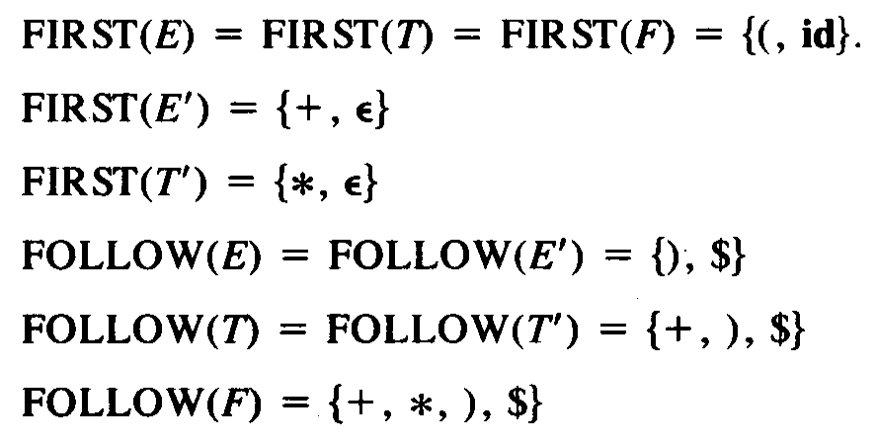
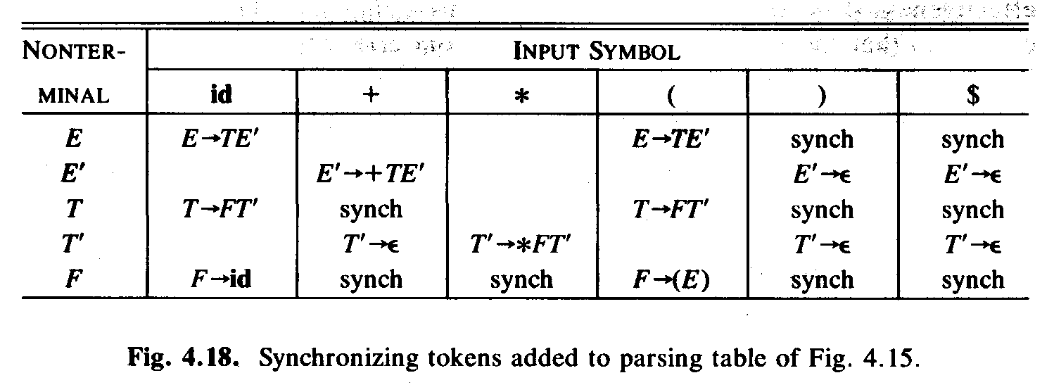
Example: error recovery
“synch” indicating synchronizing tokens obtained from FOLLOW set of the nonterminal in question.
If the parser looks up entry M[A,a] and finds that it is blank, the input symbol a is skipped.
If the entry is synch, the the nonterminal on top of the stack is popped.
If a token on top of the stack does not match the input symbol, then we pop the token from the stack.

Slide 13
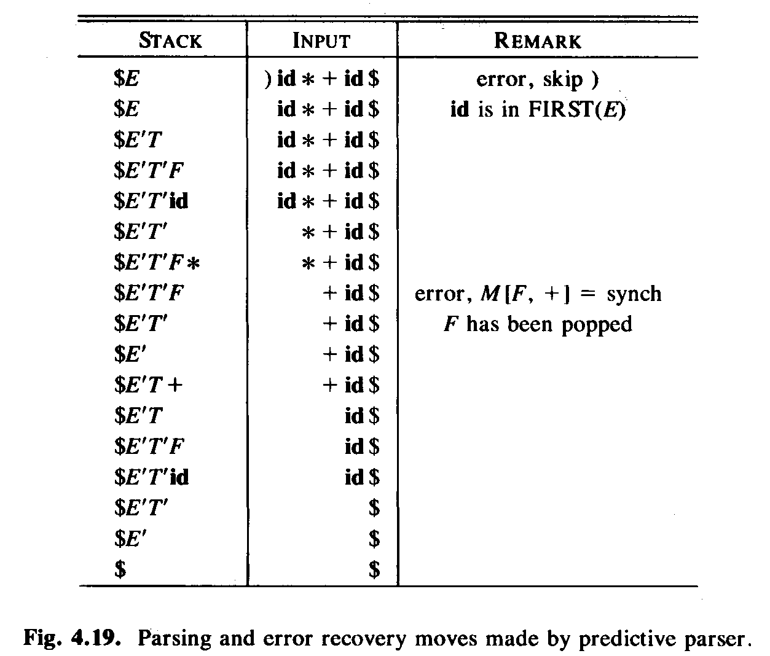
Example: error recovery (II)

